Slide 1


HR Attrition Analytics: Unlocking Insights on Employee Satisfaction & Performance
DEPI Initiative - Data Analyst Specialist Track
Group: ALX3_DAT1_G2
Under the Supervision of: Eng./Dina Ezzat

Slide 2
Team Members
(Group 3)
Moataz Tammam Abdelaziz —> Data Cleaning & Analysis
Yasmeen Farouq Saleh —> Data Cleaning & Analysis
Muhammed Nasseim El-Saied —> Data Cleaning & Analysis
Sara Ayed Wahba —> Data Visualization & Presentation Preparation
Malak Tarek Muhammed —> Data Visualization & Presentation Preparation

Slide 3
Project Overview
This project focuses on uncovering the underlying factors that lead to Employee Attrition within the company.Our analysis examines three key evaluation dimensions:
Employees' Satisfaction and Engagement.
Manager Assessments of Employees.
Employees' Self-evaluation.
These insights are derived from HR dataset across three core departments: Sales, Technology, and Human Resources.

Slide 4





Data Analysis Process
1
2
3
Data Exploration
Data Cleaning & Preparation
Data Analysis (EDA)
4
5
Data Visualization
Data Insights & Reporting

Slide 5
Understanding Data
Our HR Dataset is built on a relational database consisting of five interconnected tables:
Employee table —> Master employee table (Demographics & Employment data, Employee Attrition & tenure fields). Primary key: EmployeeID
Performance Rating —> Employee Performance & Satisfaction scores per review (ReviewDate) and training participations. Primary Key: PerformanceID, Foreign Key: EmployeeID.
Education Level —> Employees’ Educational Background.
Lookup table: mapping EducationLevelID “PK” to Employees table “FK: Education”
4. Rating Level —> Categorical description for each rating.
Lookup table: RatingID “PK” → Manager & Self-Rating “FK” in PerformanceRating table.
5. Satisfied Level —> Categorical description for each Satisfaction Criteria.
Lookup table: SatisfactionID “PK” → Environment, Job & Relationship Sats. “FK” in PerformanceRating table.

Slide 6
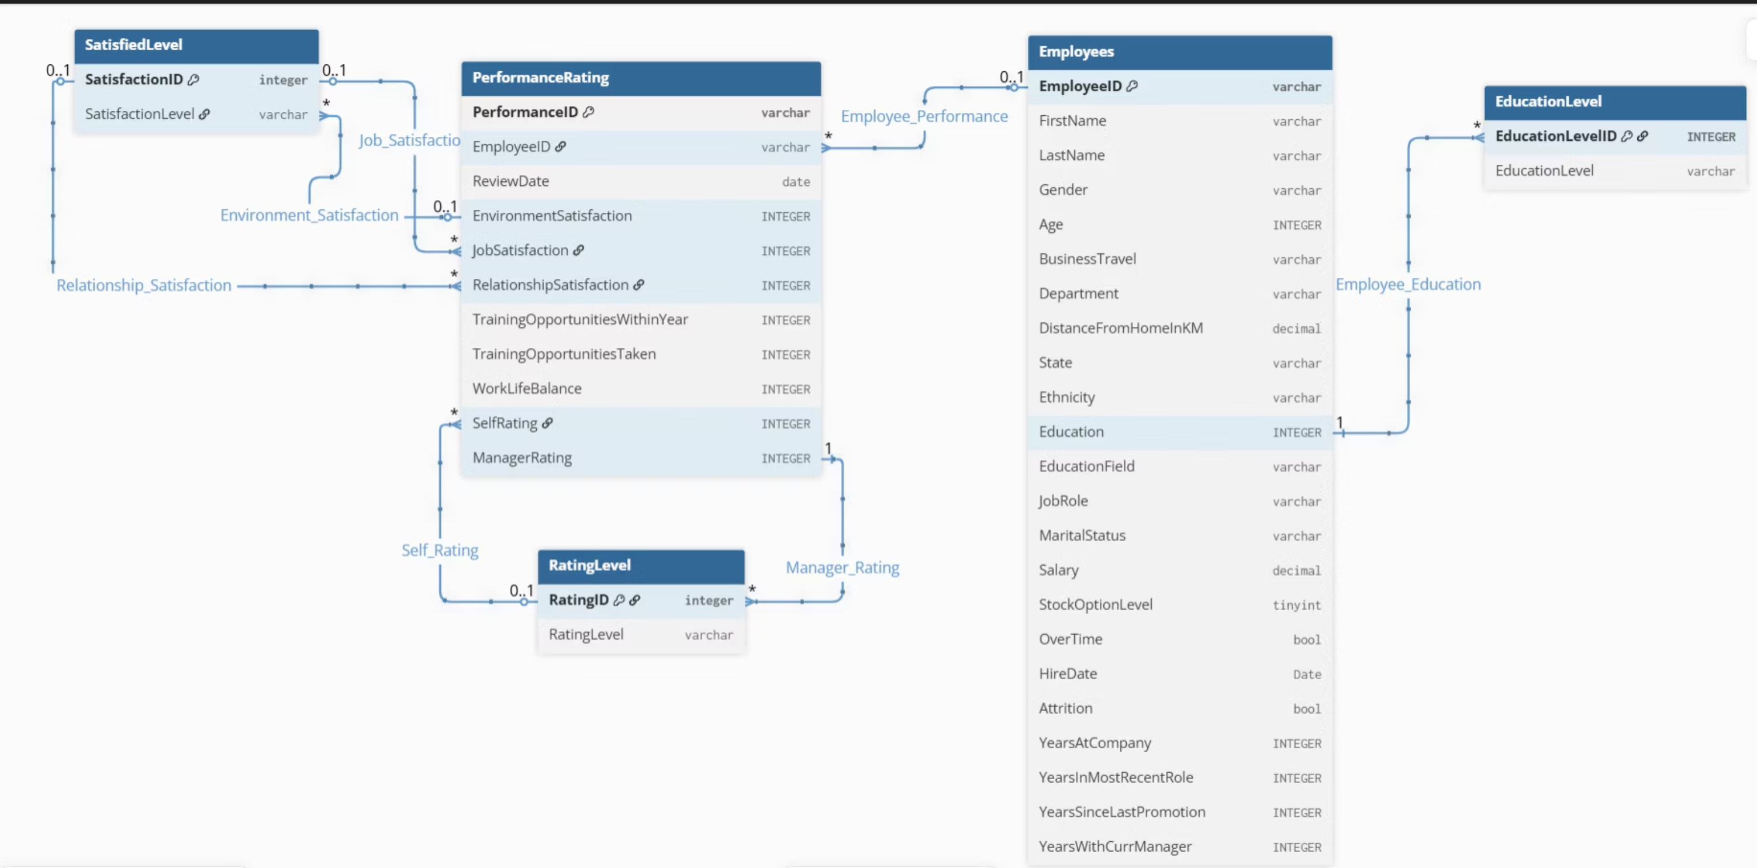
Database Schema

Slide 7
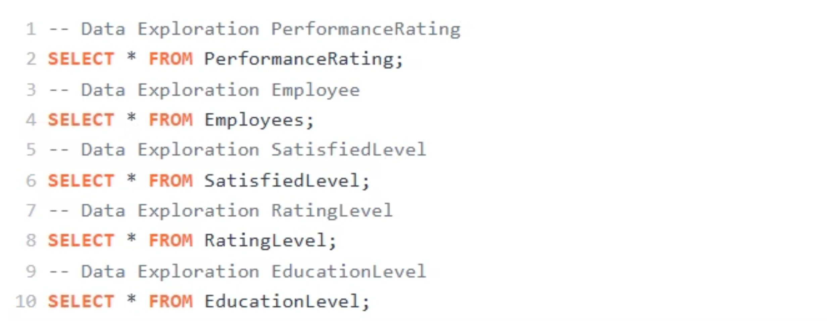
Data Loading

Slide 8






Data Cleaning & Preparation
Standardize/ Normalize Formats
Validate Results/Check Integrity and Consistency
Identifying Duplicates
Handling Missing Data

Slide 9
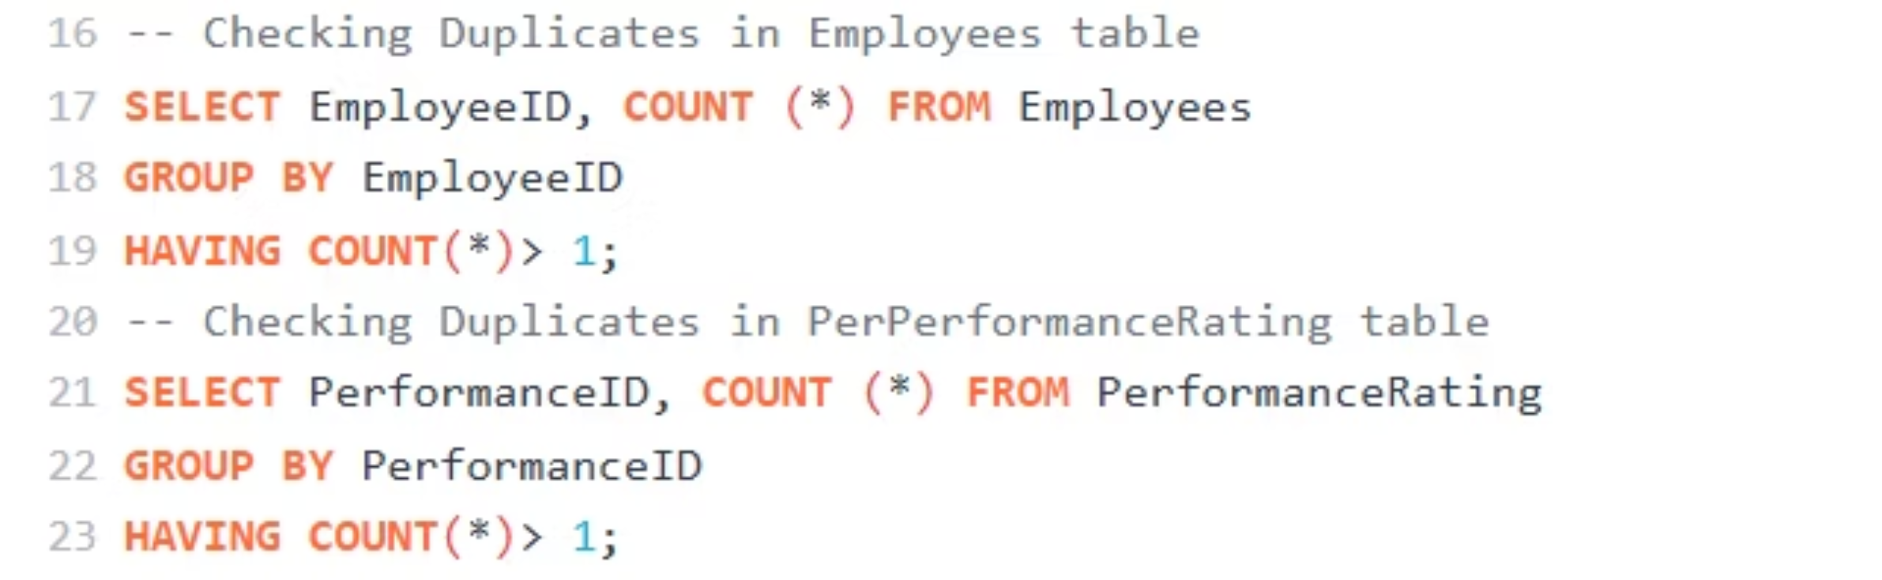

Handling Duplicates
It appears that there are no duplicates in our dataset.

Slide 10
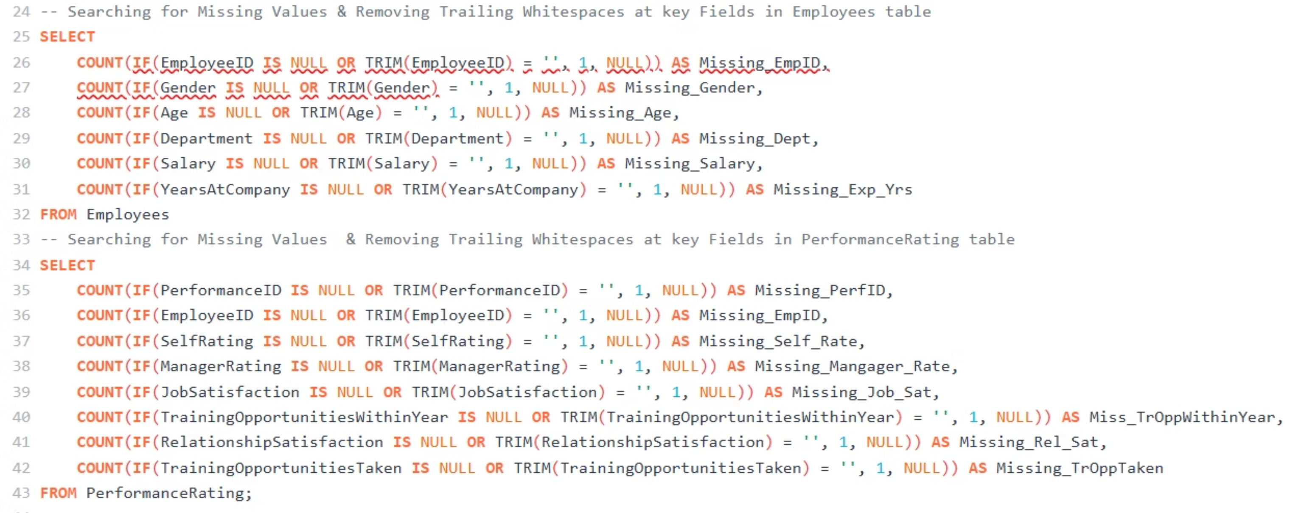

Handling Null Values
It appears that there are no Null Values in our dataset.

Slide 11
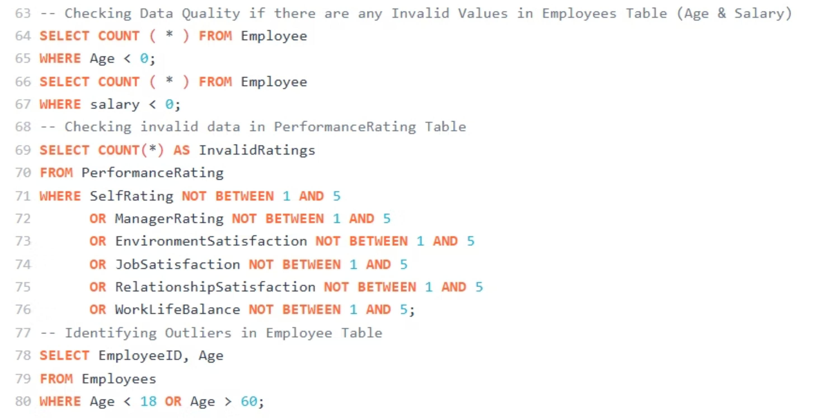
Checking Invalid Data (Ensure Data Quality)

Slide 12
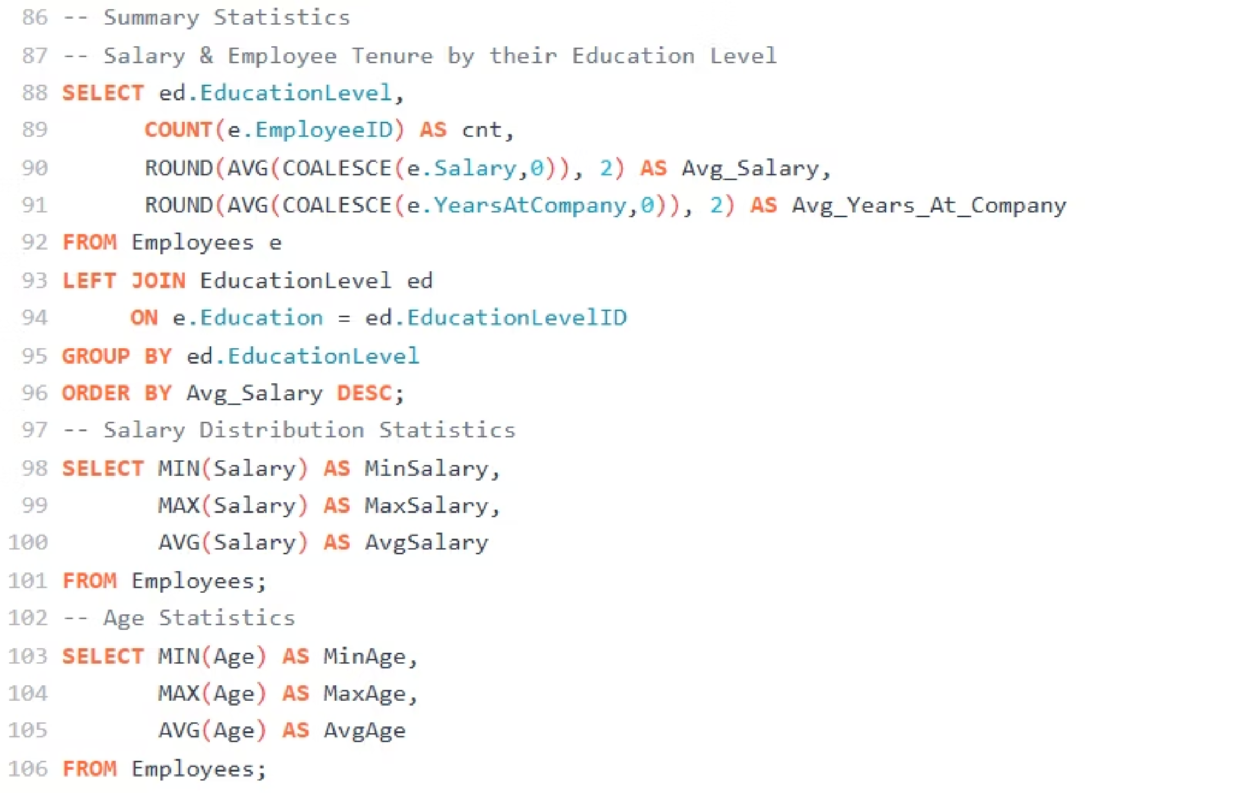
Exploratory Data Analysis (EDA)
To examine & investigate datasets to discover patterns, trends & spot anomalies.

Slide 13

Focus Areas of Analysis
1
2
3
Factors influencing Employee Satisfaction and Attrition
Overtime Impact on Employee WLB & Performance
Correlation between Salary and Satisfaction or Performance
4
5
Training Impact on Performance & Promotion Potential
Common Characteristics of Attritors

Slide 14
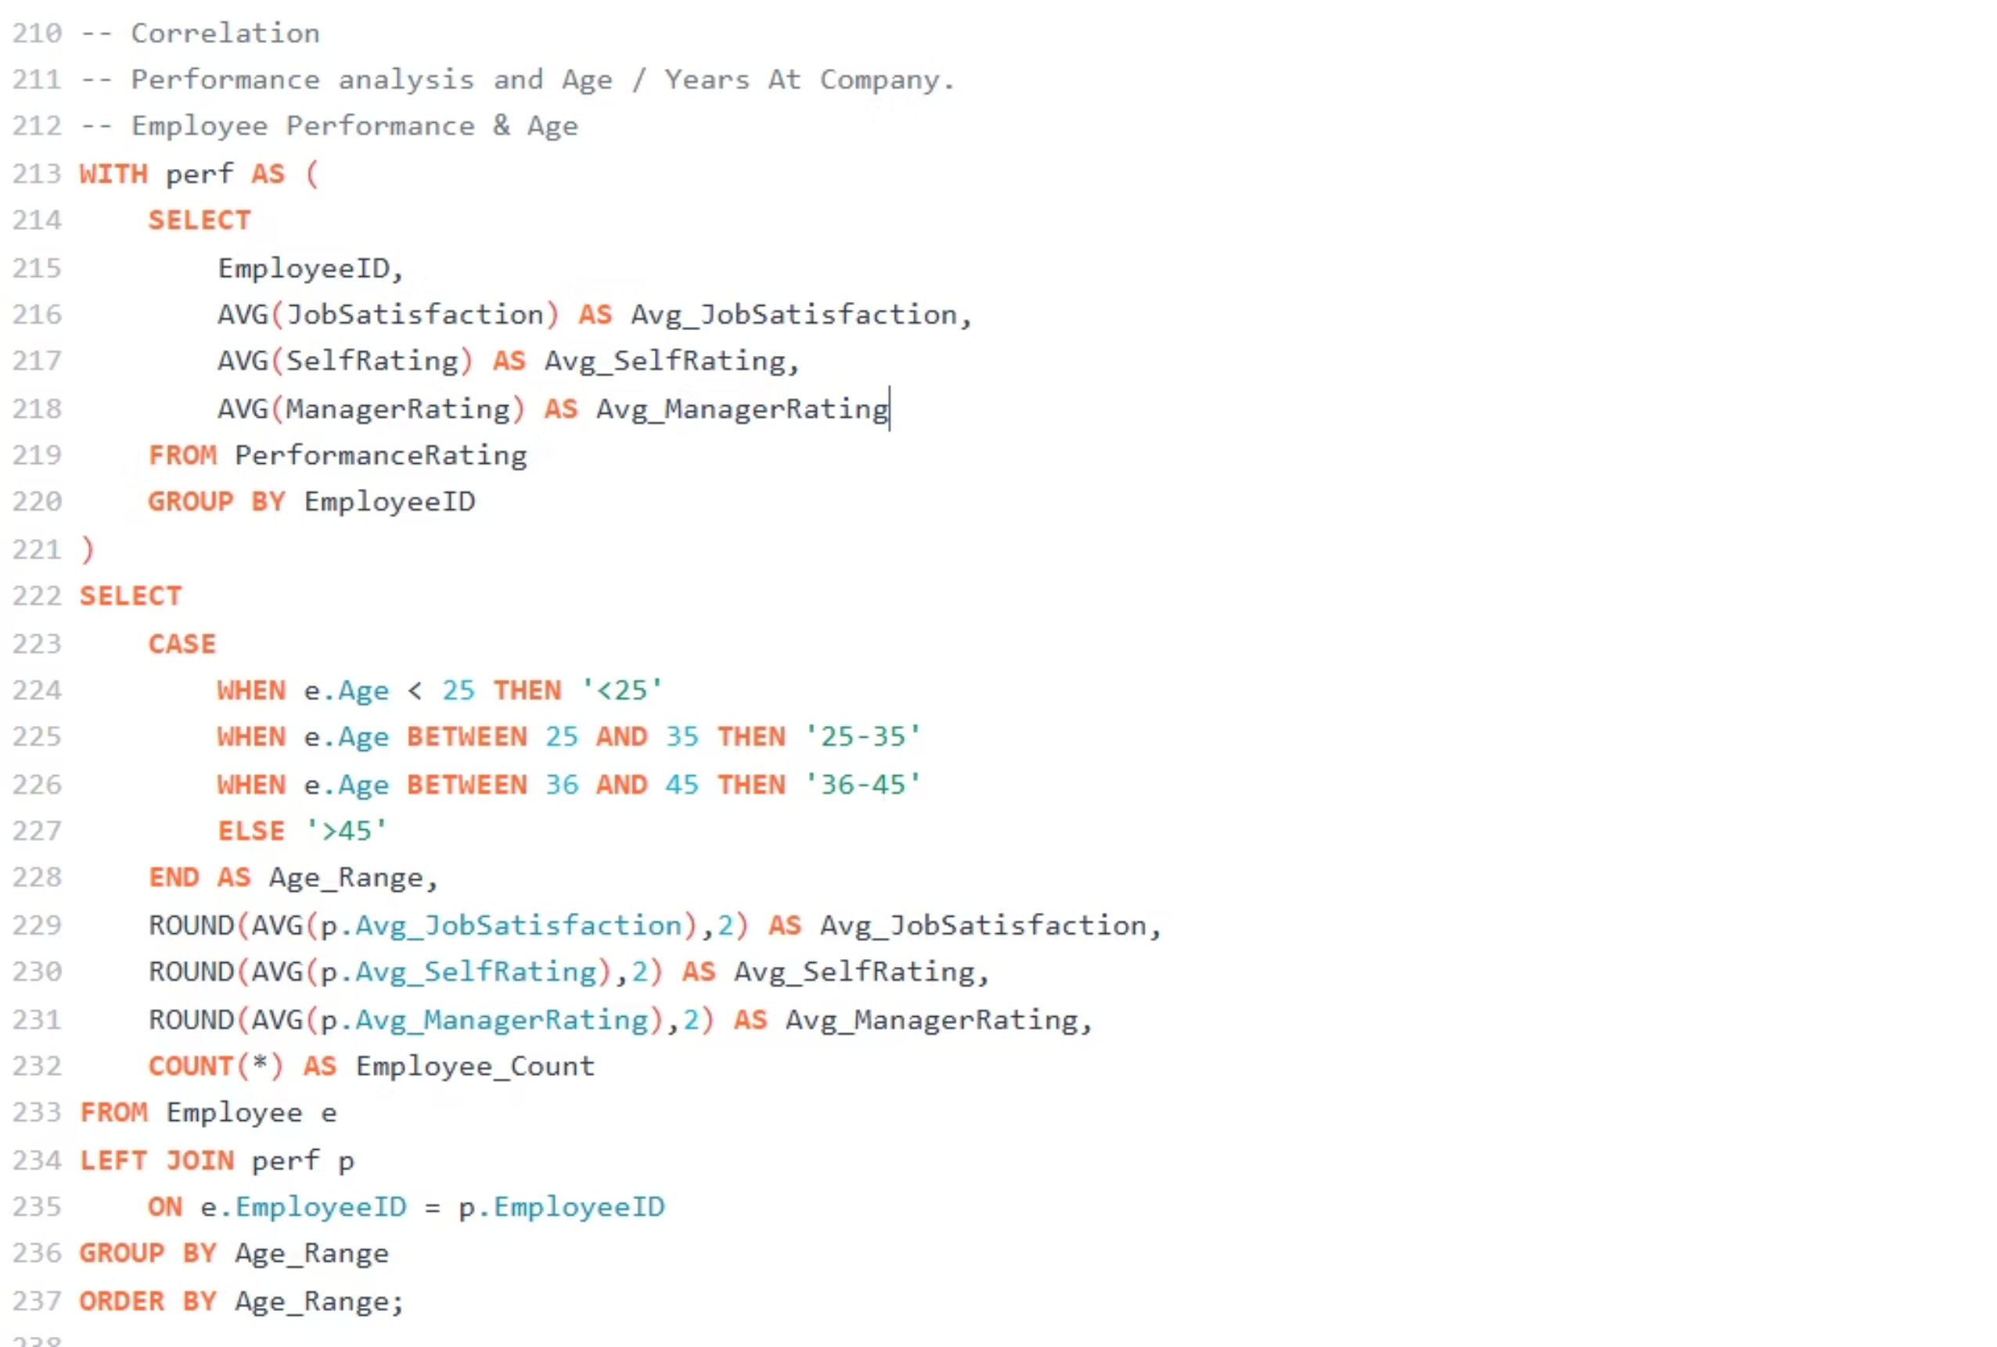
Performance Analysis (Performance Correlation with Age)

Slide 15
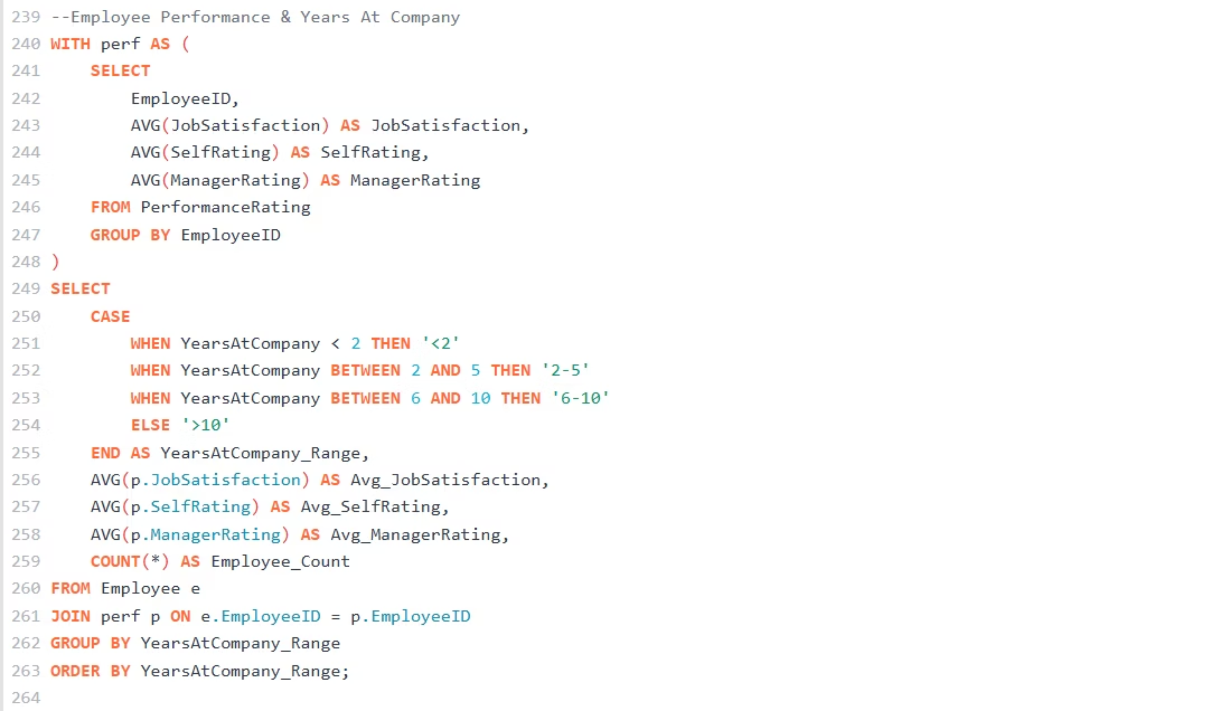
Performance Analysis (Performance Correlation with tenure)

Slide 16
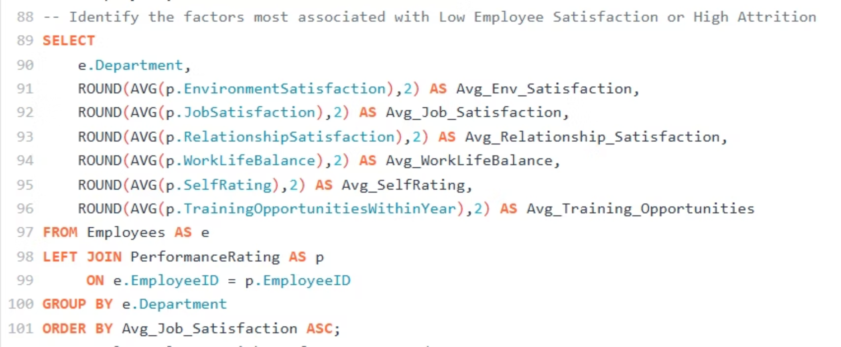
Factors influencing Employee Satisfaction and Attrition

Slide 17
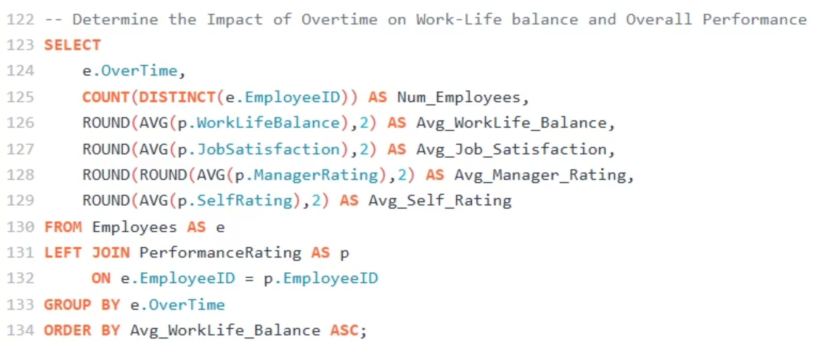
Overtime Impact on Work-Life Balance and Employee Performance:

Slide 18


Overtime Impact on Employee Performance
Overtime and Job Satisfaction
Overtime had a noticeable effect on job satisfaction. Employees who worked extra hours reported higher satisfaction compared to those who did not (3.51 vs 3.38).
Overtime and Performance
Employees who did not work overtime have higher manager rating average of 3.47 compared to 3.45 for those who do.

Slide 19
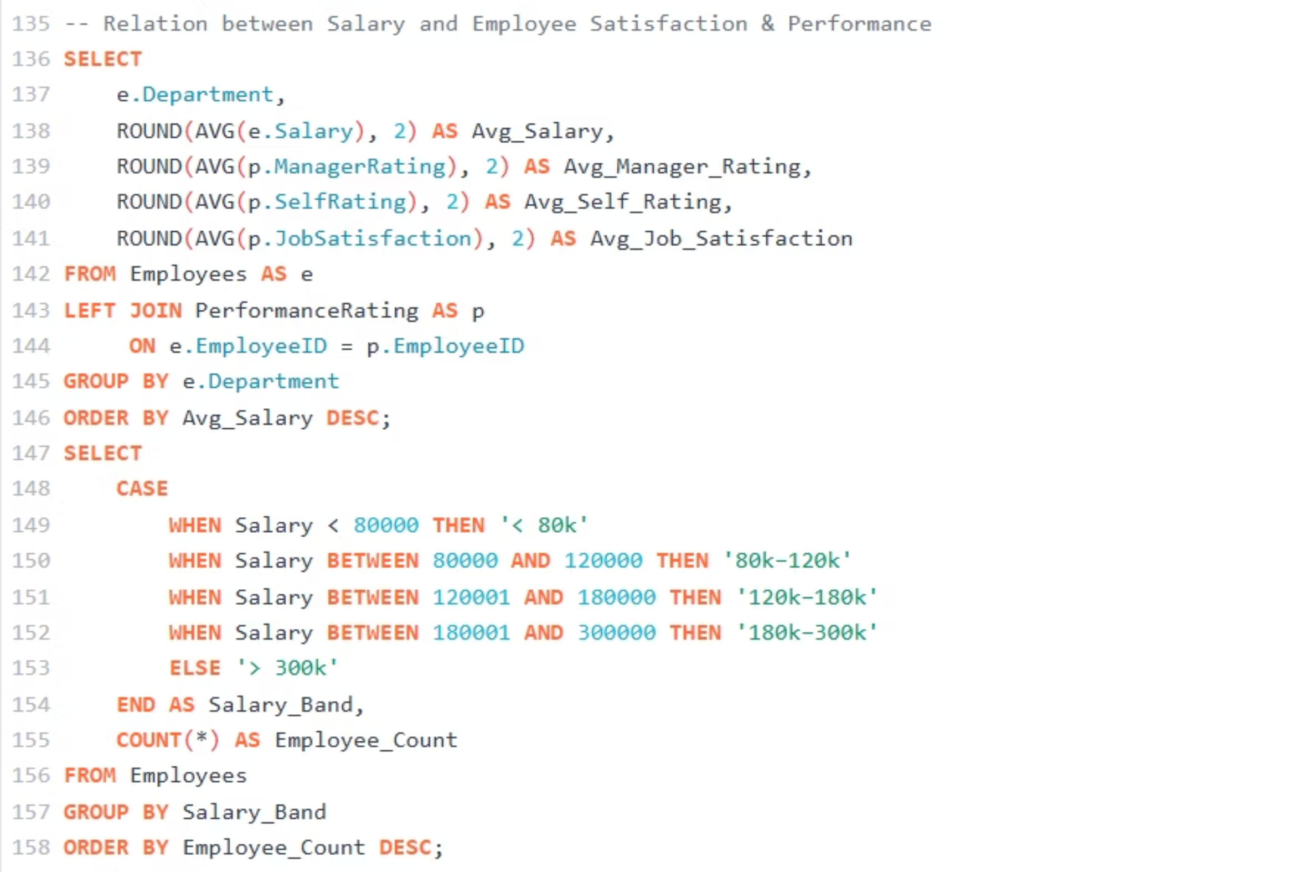
Relation between Salary and Employee Satisfaction & Performance

Slide 20
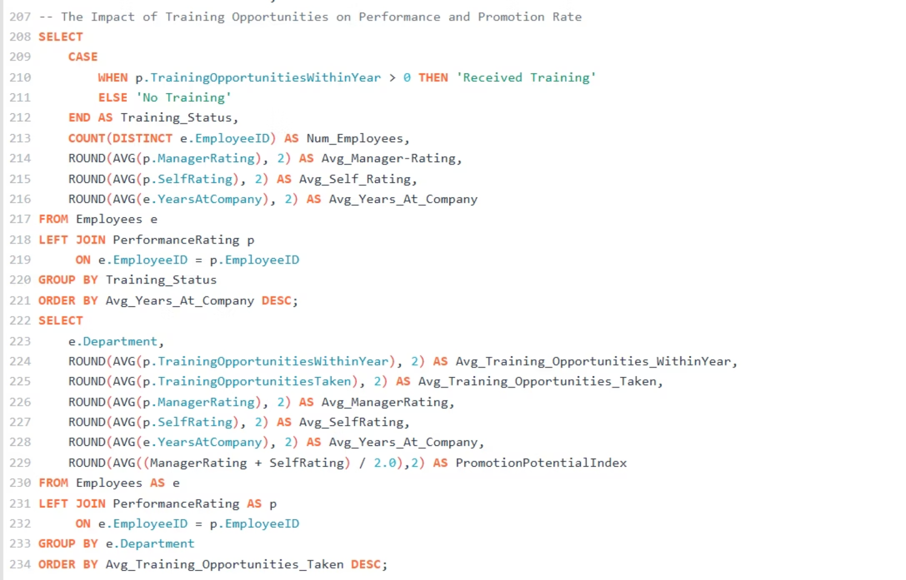
Training Opportunities Impact on Performance & Promotion Potential
HR Department has the lowest training opportunities (Average: 0.96), but the highest Performance "Manager Rating" (Average: 3.49).
Sales Department has slightly higher training opportunities (Average: 0.99), but the lowest Performance (Average: 3.43).
Technology Department has the highest training opportunities (Average: 1.04) and Manager rating of (Average: 3.47).

Slide 21
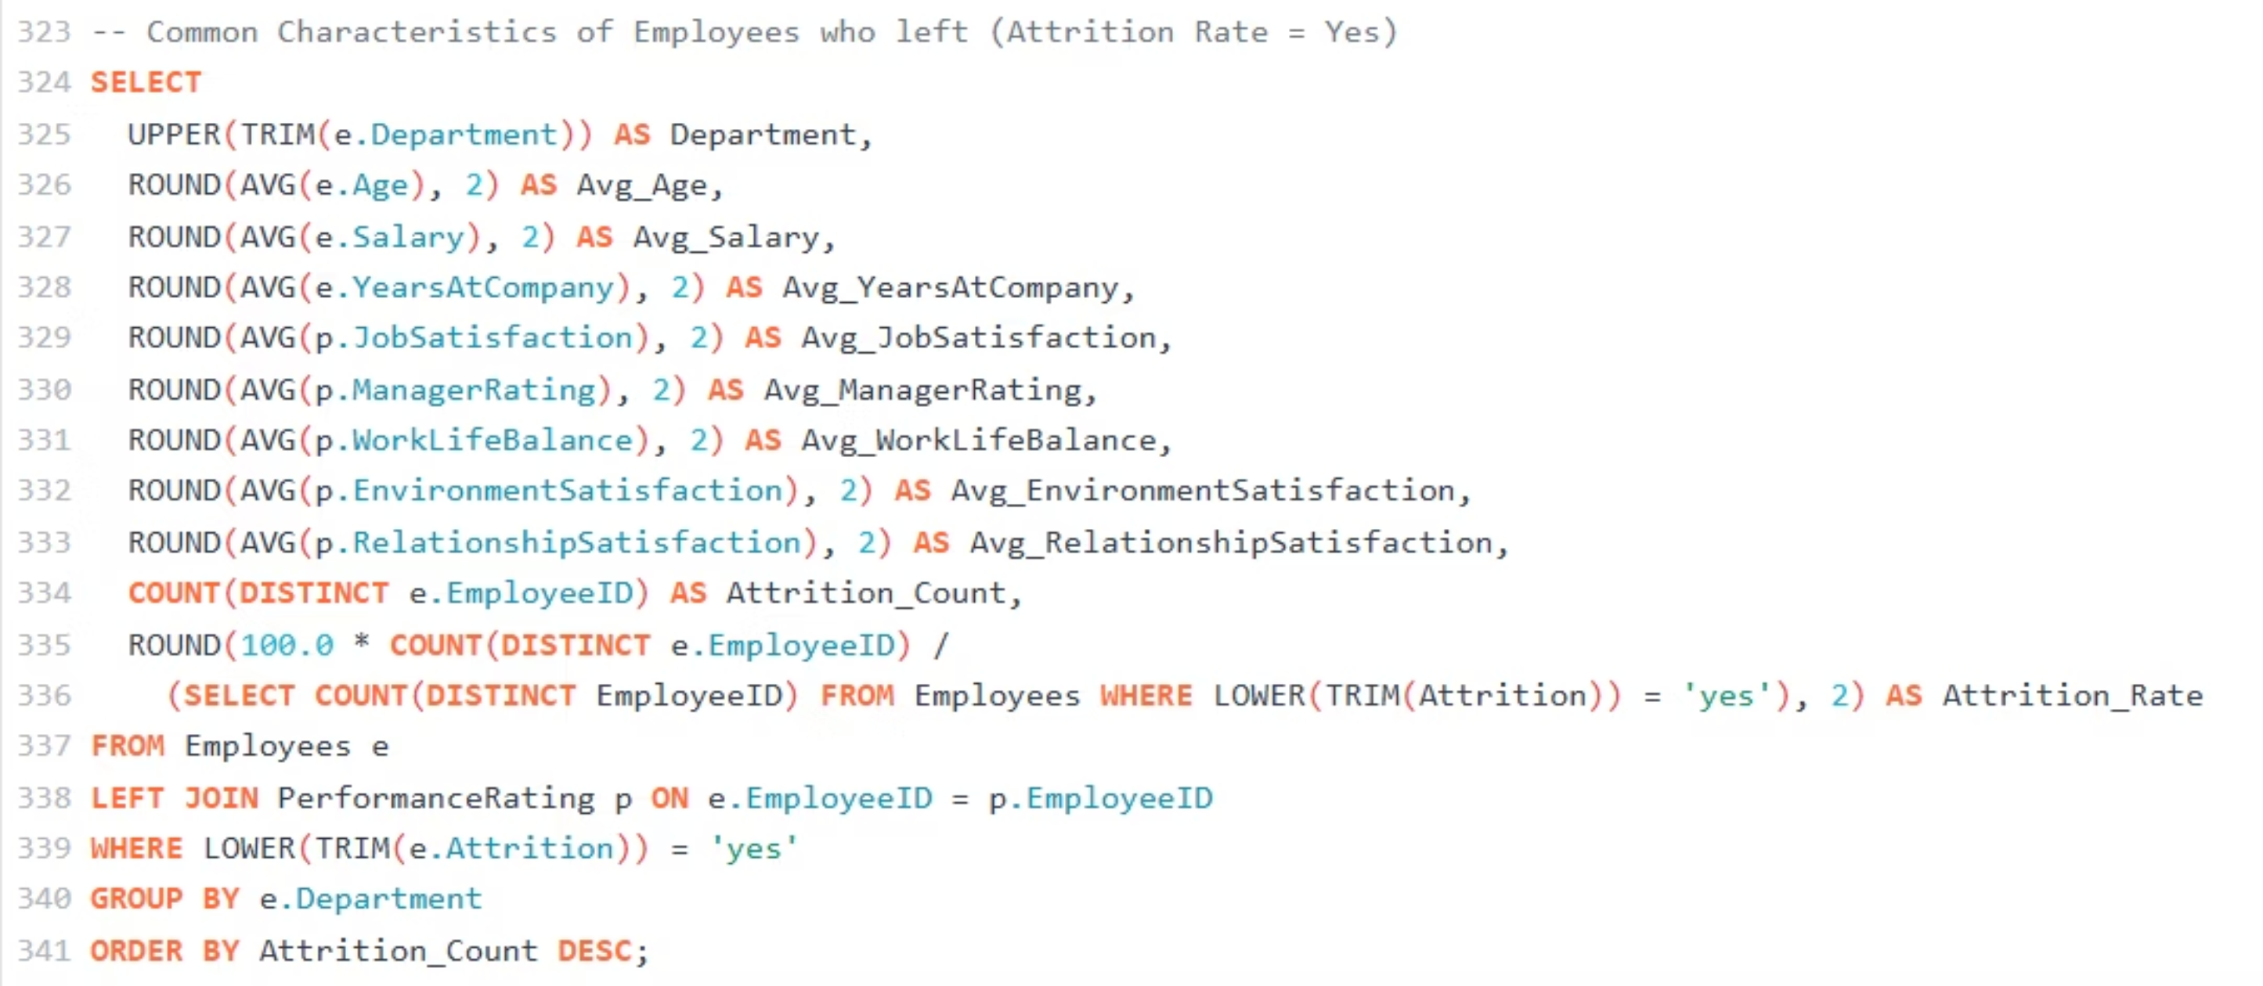
Common Characteristics of Employees who Left
Employees who are younger, less incentivized, and have shorter tenure tend to leave at higher rates.

Slide 22
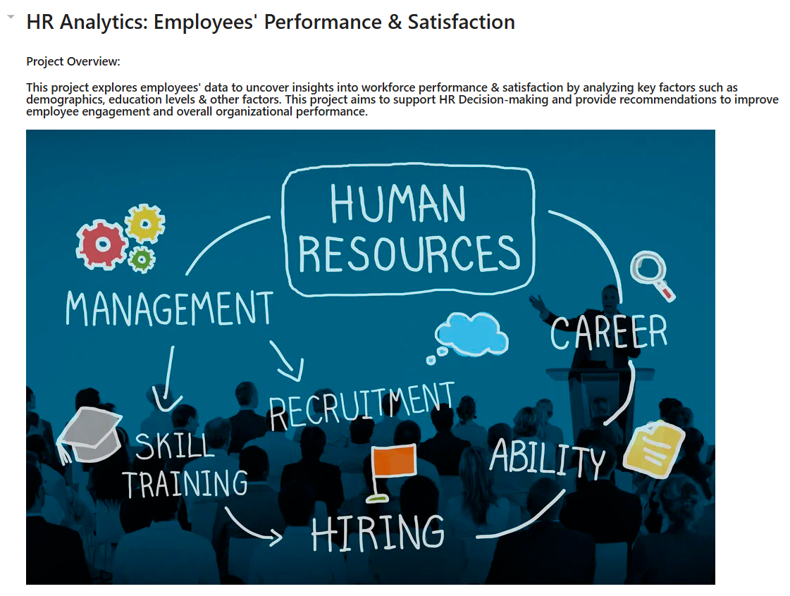
HR Project Jupyter Notebook "Python"

Slide 23
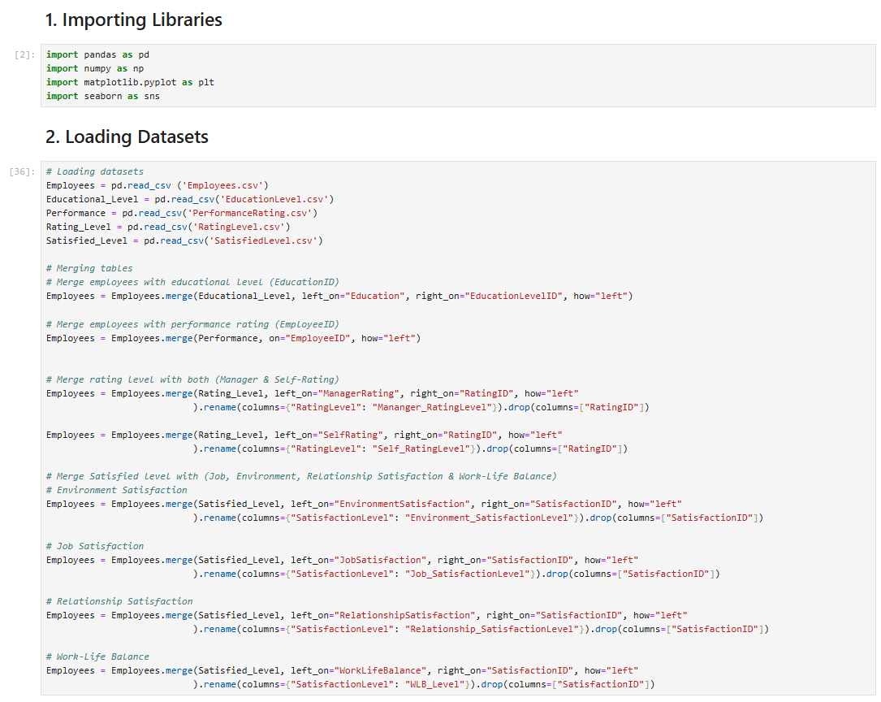
Importing libraries & Loading our Dataset

Slide 24
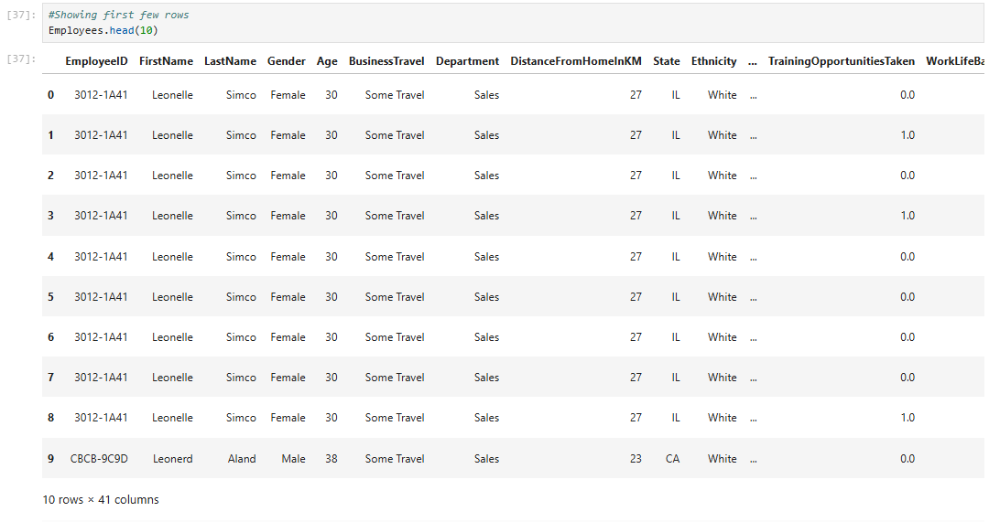

Slide 25
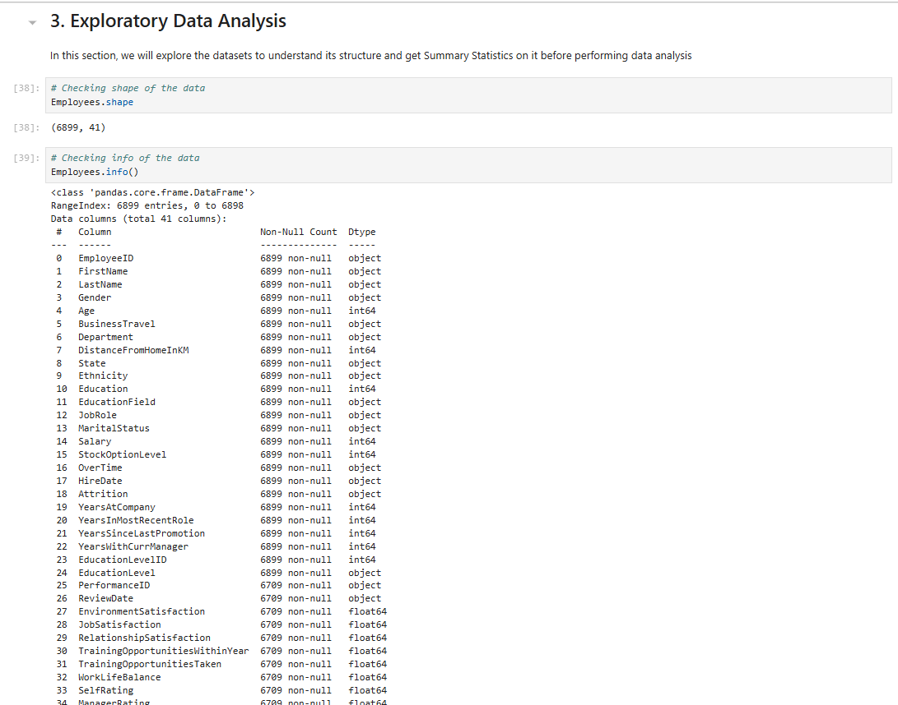
Exploring our Dataset (EDA)

Slide 26
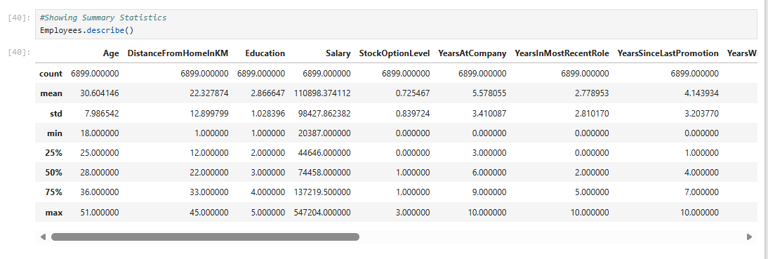
Descriptive/ Summary Statistics

Slide 27
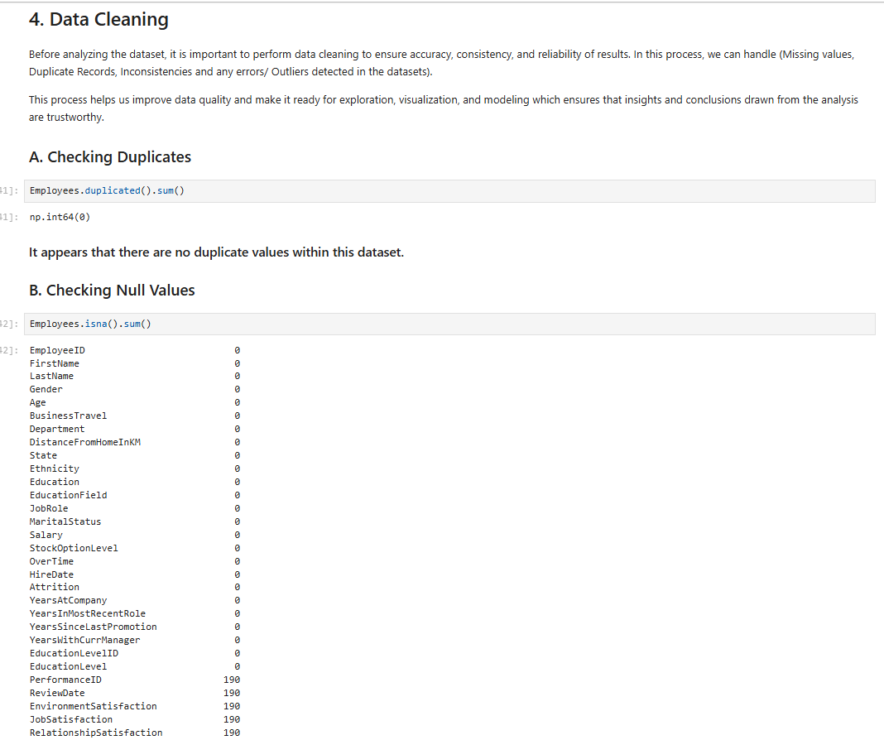
Data Cleaning (Checking Nulls & Duplicates)

Slide 28
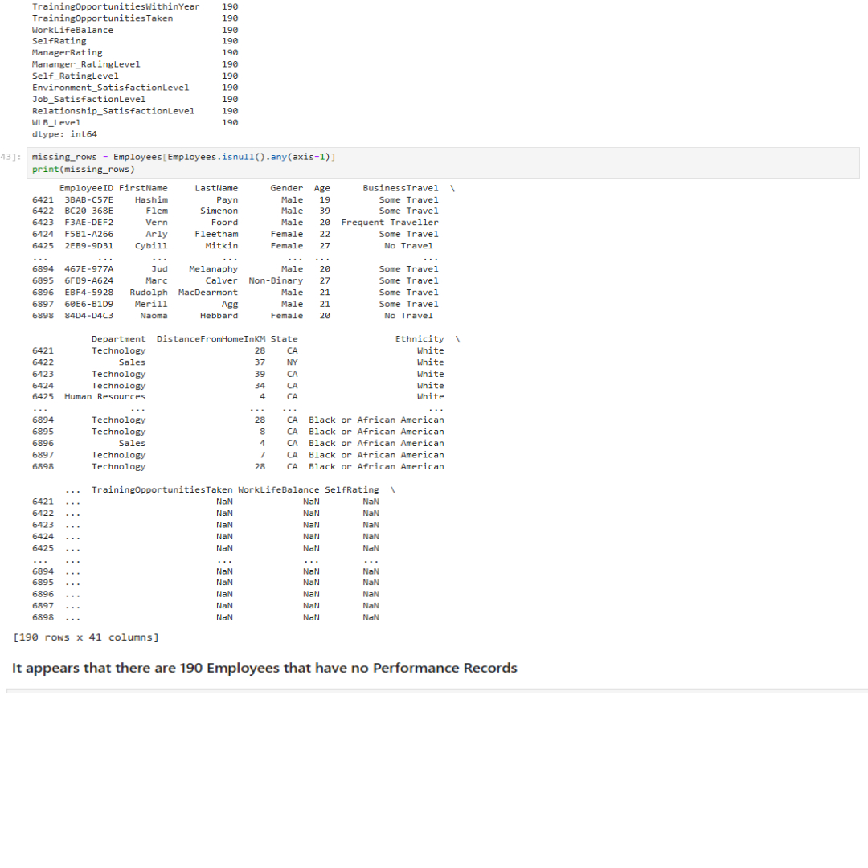
Data Cleaning (Checking Nulls & Duplicates)

Slide 29
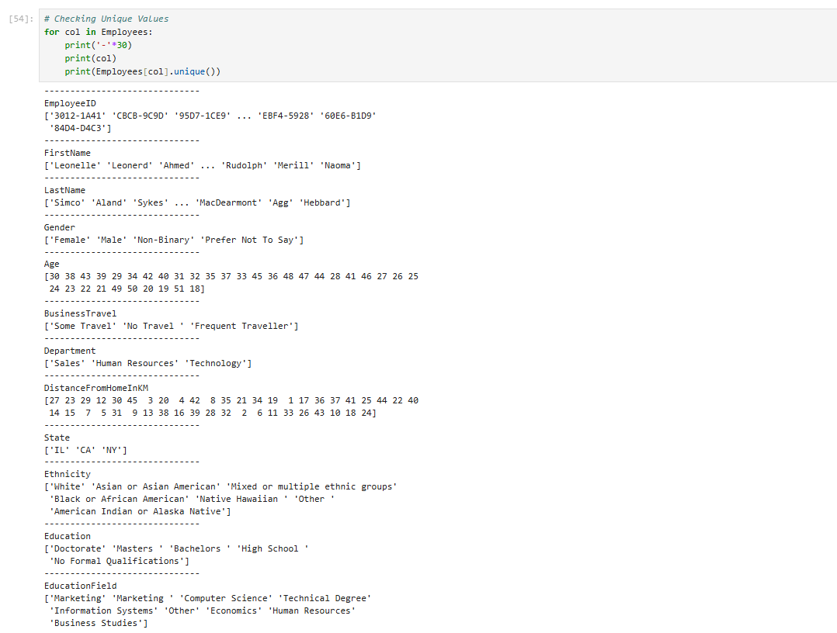
Checking Unique Values

Slide 30
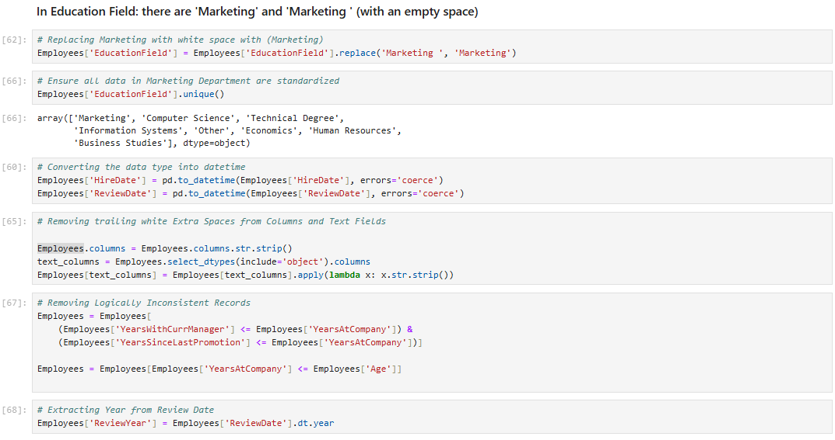
Trimming Extra Spaces & Removing Inconsistencies

Slide 31
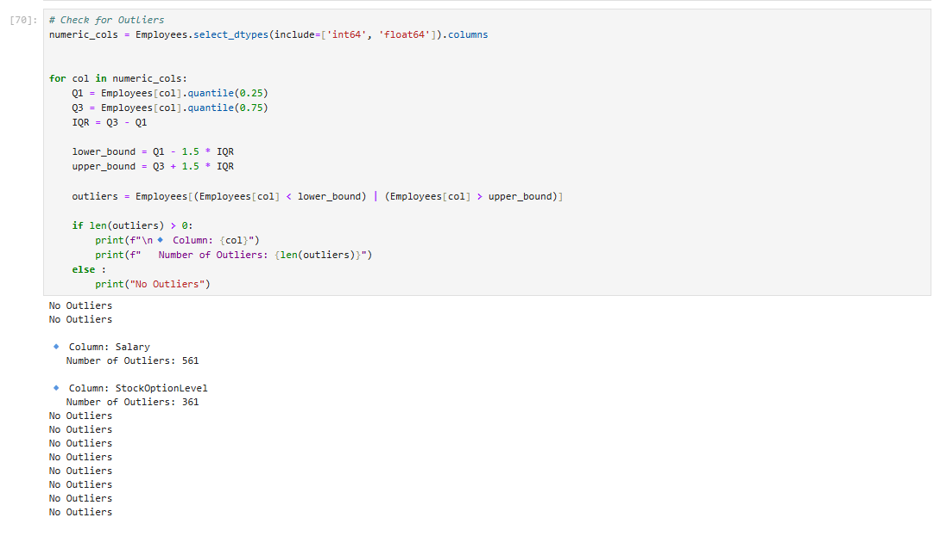
Checking if there are any Outliers

Slide 32
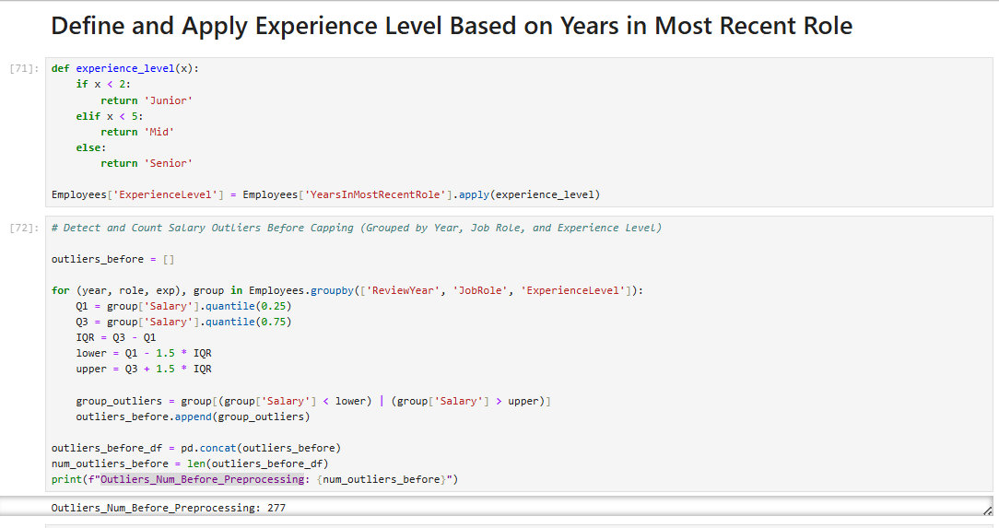
Experience Level in relation to Years in Recent Role

Slide 33
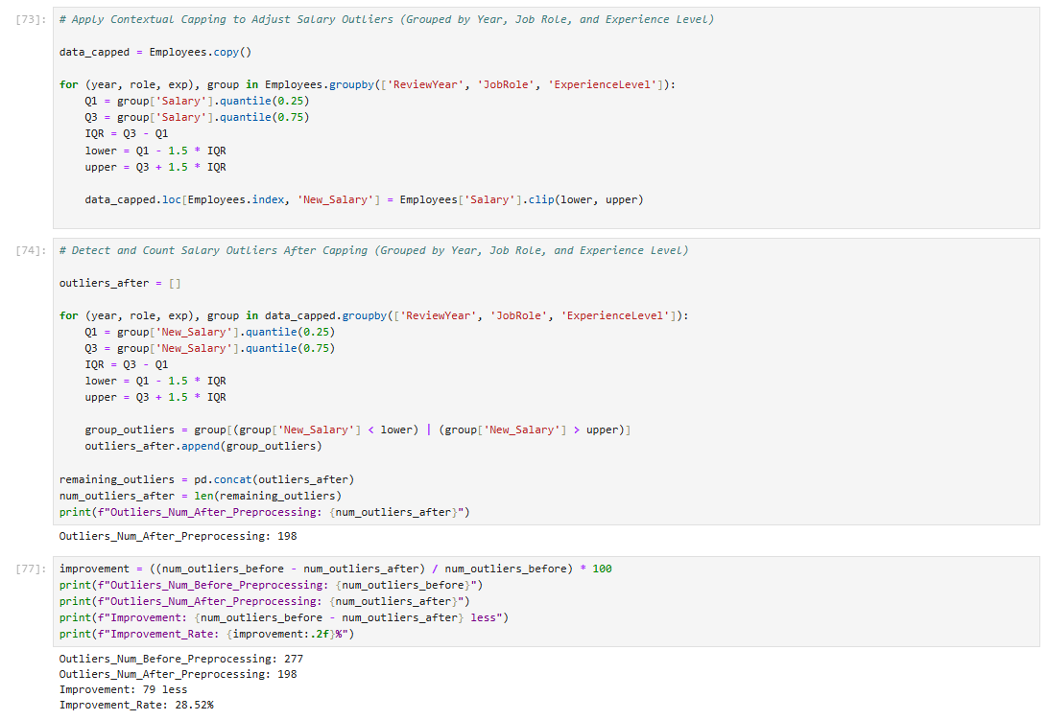

Slide 34
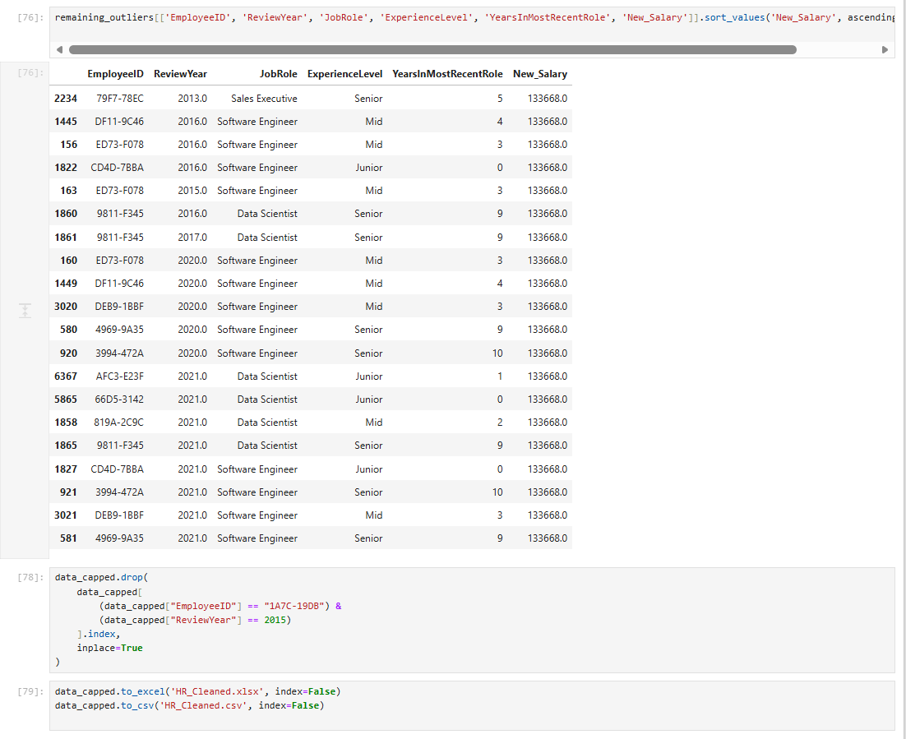

Slide 35
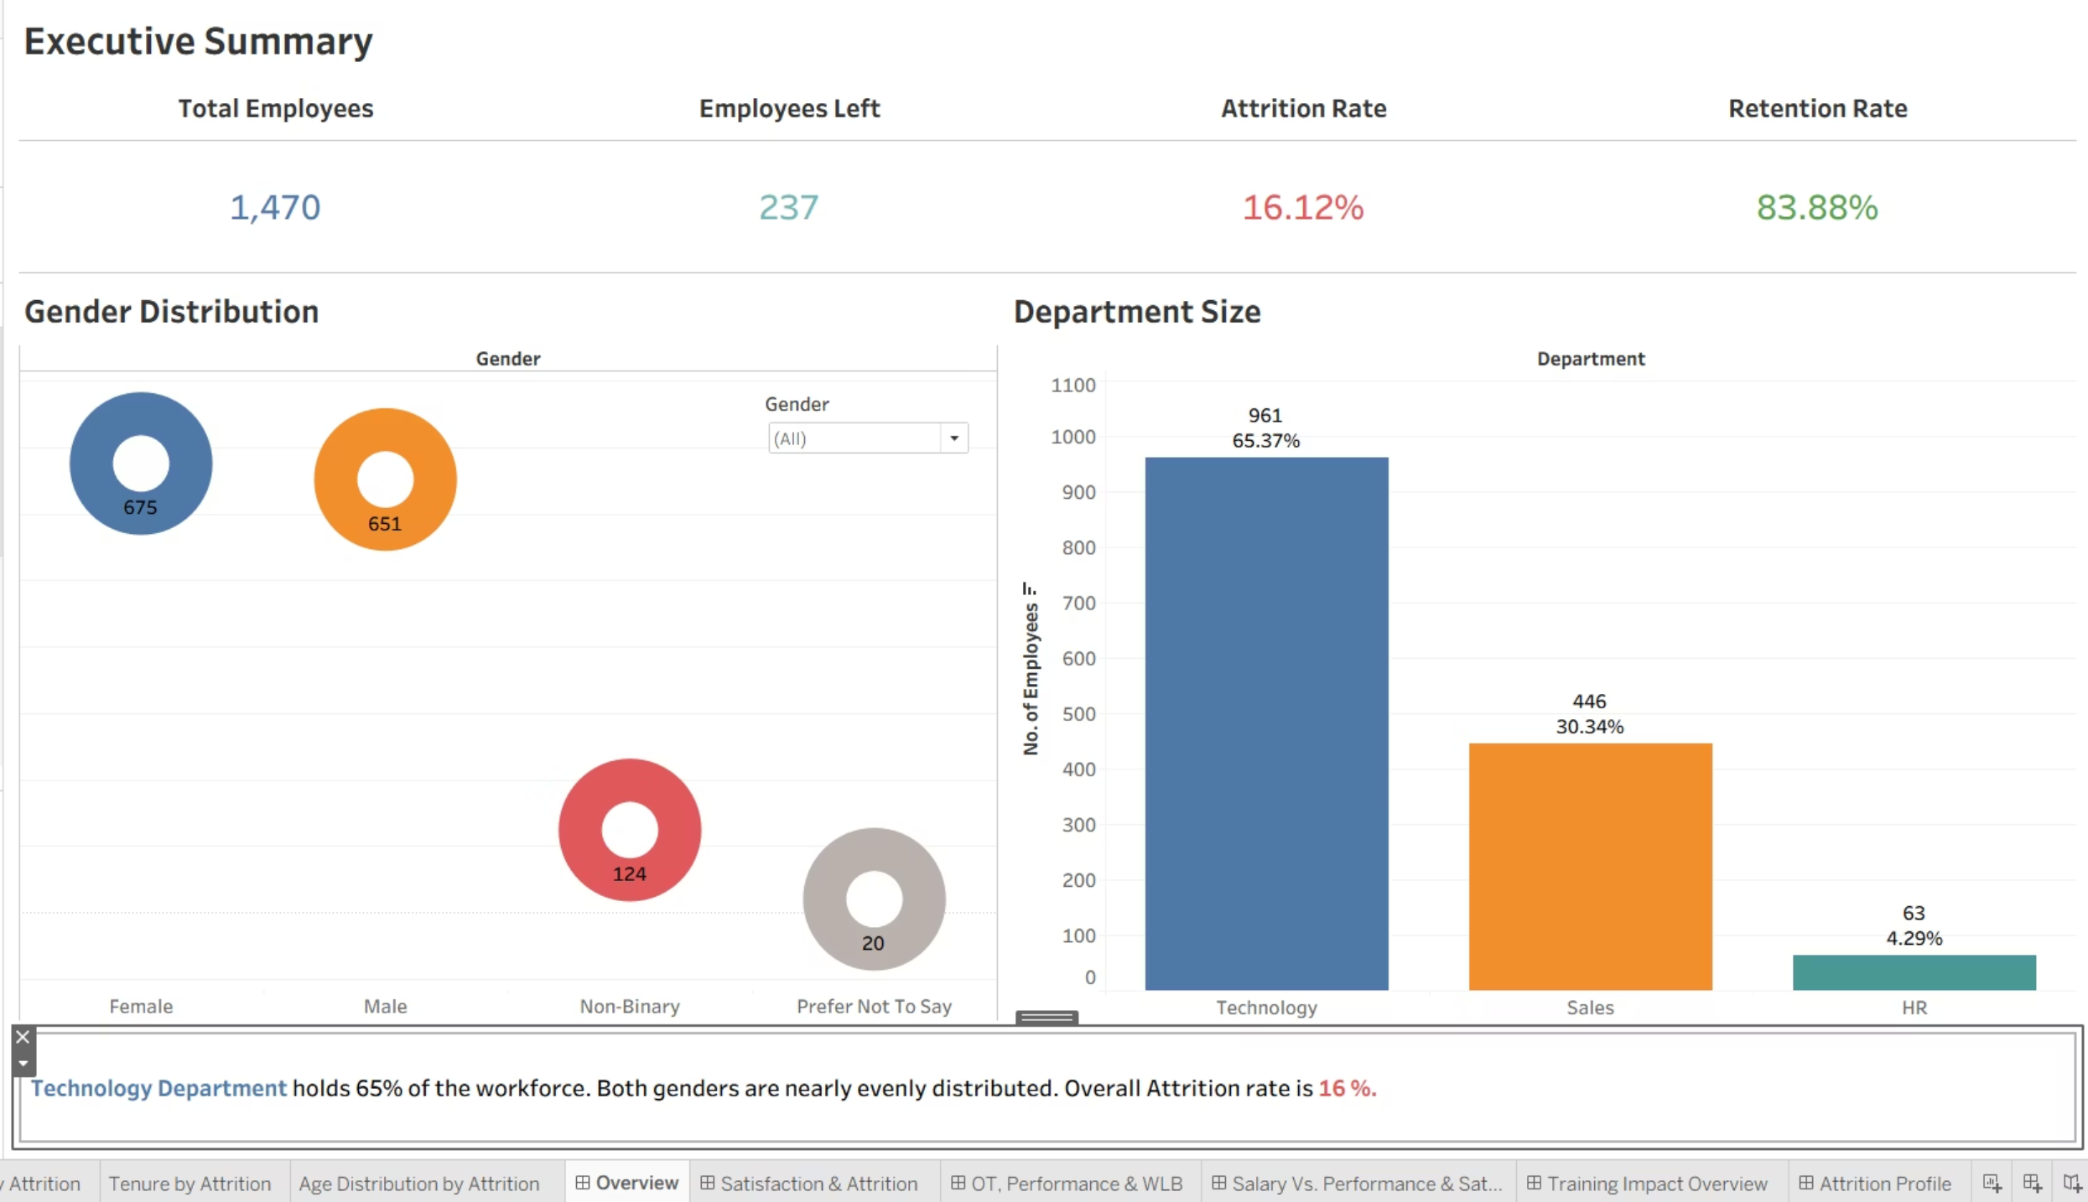
Data Visualization (Tableau Dashboard)
An Overview for HR Attrition Project

Slide 36
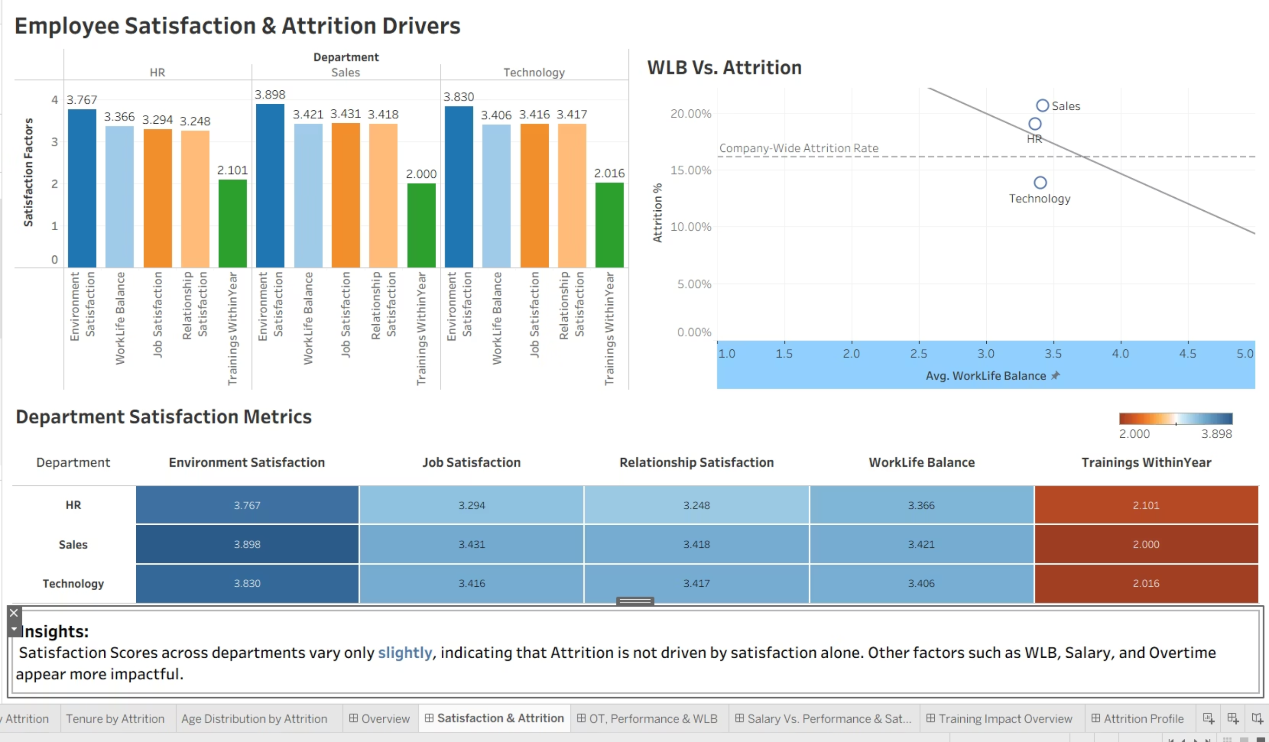
Satisfaction Drivers Dashboard

Slide 37
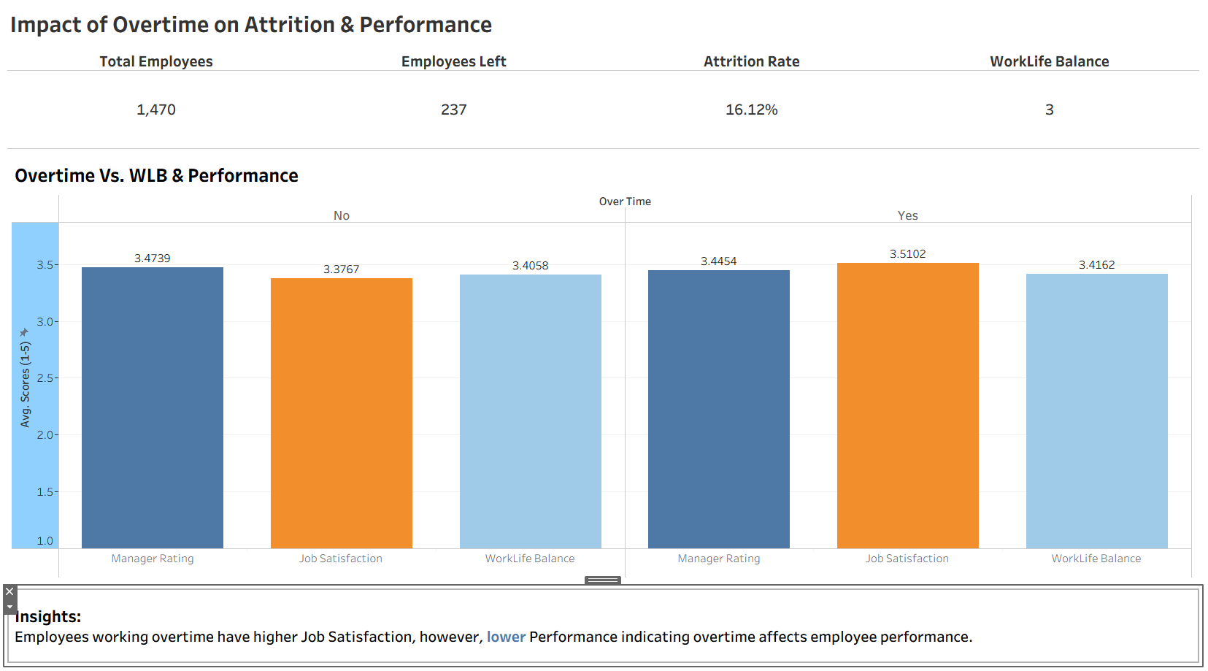
Overtime Impact Dashboard

Slide 38
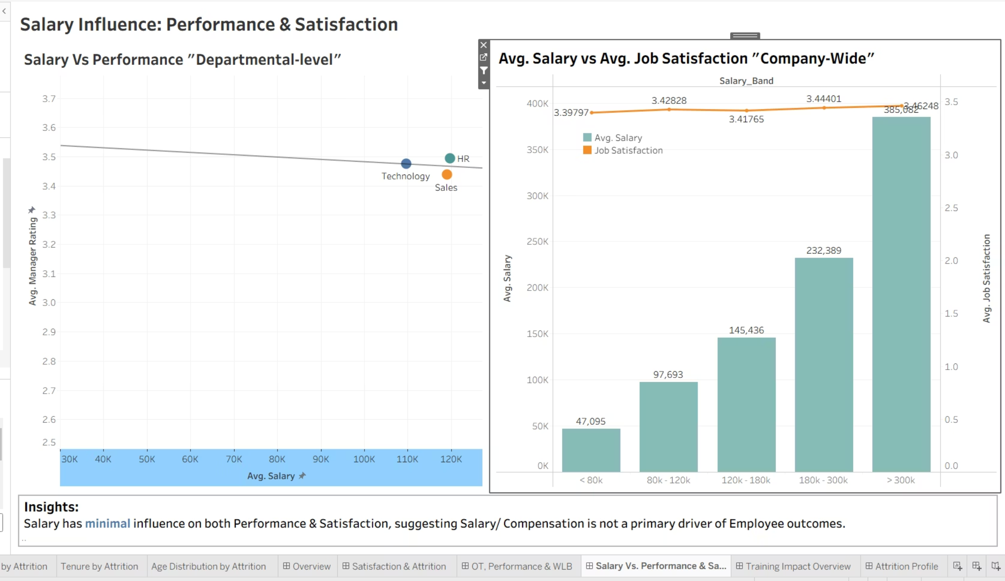
Salary Influence Dashboard

Slide 39
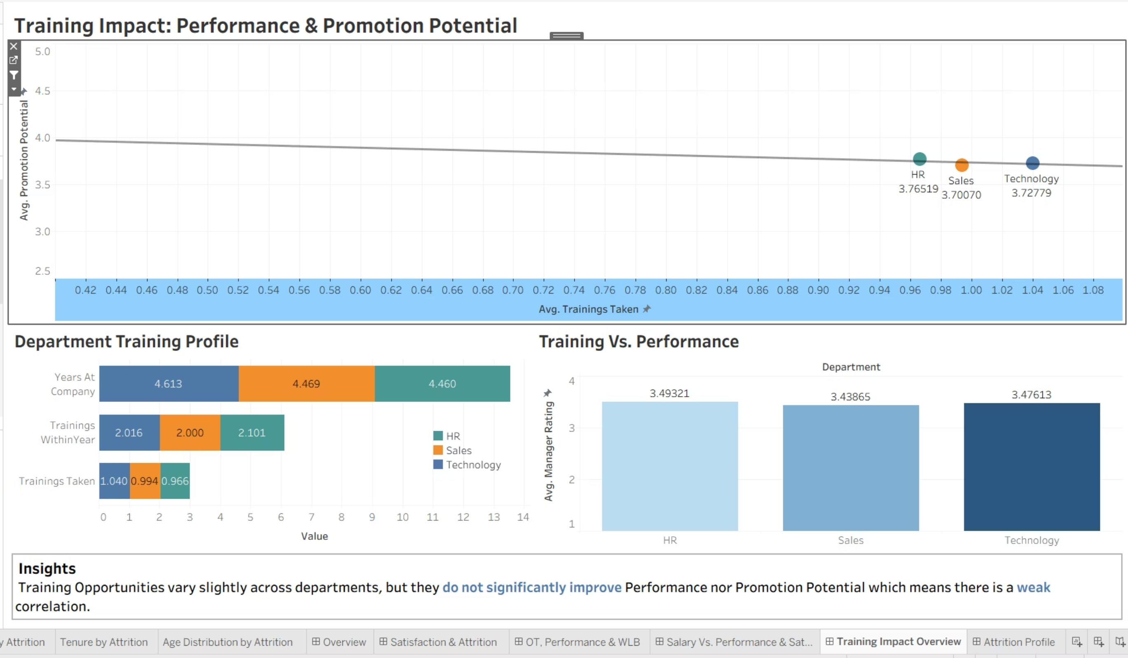
Training Impact Dashboard

Slide 40
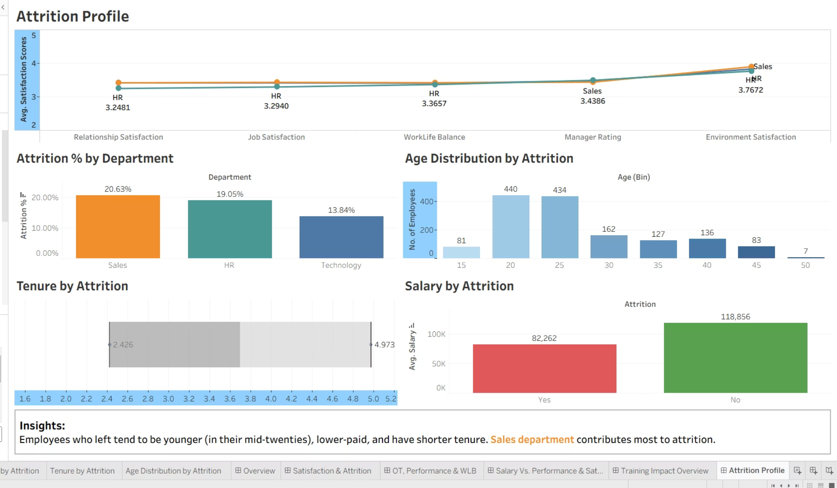
Attrition Profile Dashboard

Slide 41

Conclusion
Our HR Analytics project revealed several key patterns shaping Employee Satisfaction and turnover:
The Technology department dominates the workforce (65%), and gender distribution is nearly balanced across the organization.
Attrition is moderately high at 16%, but satisfaction scores across departments remain relatively consistent, suggesting that Attrition is not driven by Satisfaction alone, but rather by other operational and behavioral factors.
Salary level shows Limited influence on Satisfaction or Performance, suggesting compensation is not the main concern for most employees.
Training opportunities show Weak impact on Performance or Promotion readiness, indicating current programs may lack effectiveness or alignment with role needs.
Employees who leave are generally younger, earlier in their careers, lower-paid, and have shorter tenures. The Sales department contributes most to the overall attrition rate.

Slide 42






Recommendations to effectively reduce Employee turnover & strengthen Employee Experience
Enhance WLB Company-Wide
Introduce flexible scheduling, remote-work options, or mandatory time-off initiatives.
Improve Early-Career Retention
Create structured career paths, mentorship programs, and faster development cycles targeting younger, low-tenure employees who are most at risk.
Regularly monitor WLB metrics for early warning signs.
Address High Attrition in Sales Department
Create growth pathways to reduce early exits.
Review workload, targets, incentives, and managerial support practices.
Conduct focused interviews or targeted pulse surveys to uncover department-specific stressors.

Slide 43



Recommendations to effectively reduce Employee turnover & strengthen Employee Experience
Maintain Transparent Compensation Strategy
Reassess Training Strategies
While salary is not a primary turnover driver, ensure fairness across levels and roles to prevent future dissatisfaction.
Shift from quantity to quality and relevance: design role-specific, skill-based, and progression-aligned development programs.
Evaluate training effectiveness and ensure it contributes to skill growth and promotion readiness.
Adopt Predictive Analytics (Strategic Add-On)
Build attrition prediction models to proactively identify high-risk employees and intervene early.

Slide 44

Thank You!
Feel free to ask any questions!

